Slide 1
A note to teachers …
Dear Educators,
Thank you for your interest in our Soils: Fundamental to Life powerpoint. This powerpoint was developed for the webinar of the same title, presented April 17, 2018. This has been updated to include the appropriate sources and credits for the images within the presentation.
You are welcome to use any/all of the information in this presentation for educational purposes – please include the appropriate credits.
Due to the size of the powerpoint, it has been compressed and divided into two parts. This is Part Two.
If you have any questions, please contact us at membership@soils.org and be sure to view all of our K12 resources at www.soils4teachers.org and www.soils.org/IYS .

Slide 2
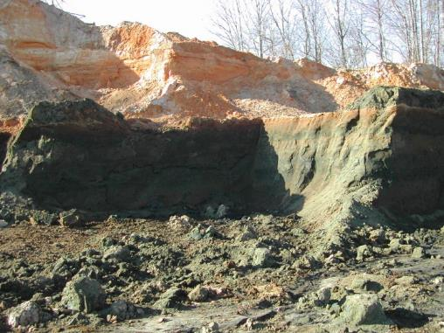
Characteristics of Soil
Soil Profile
Soil Texture
Soil Color
Soil Structure
Photo Credit: Wale Adewunmi
Soil Science Society of America

Slide 3
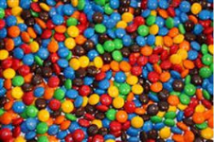
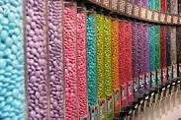
Soil Color
Like M&Ms…
…soils have colors
It is an indicator of certain chemical and physical characteristics.
Photo Credit: www.lovethispic.com/image/45129/tubes-of-m-ms
Soil Science Society of America

Slide 4
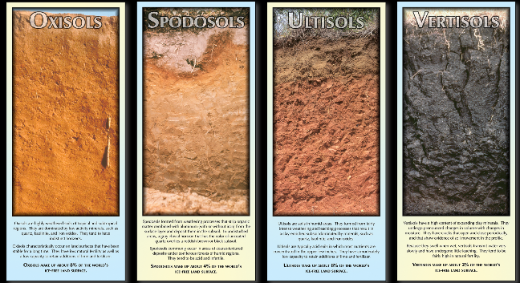
Photo Credit: USDA-NRCS
Soil Science Society of America
Notes:
What is different about these pictures?

Slide 5

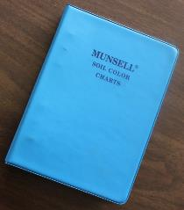
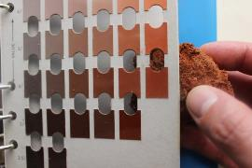
Soil Color
Info
Sheet!
Since color perception is subjective, soil color is determined using a standardized chart.
Photo Credit: Wale Adewunmi
Soil Science Society of America

Slide 6
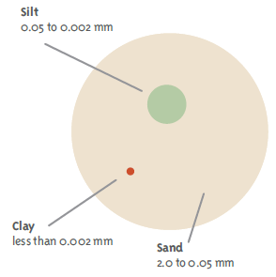


Soil Texture
Every soil can be separated into 3 physical sizes based on the diameter of the particles.
Sand + Silt + Clay = Soil Texture
The relative proportion (mixture) of the 3 sizes and the way it feels to the hand is what is referred to as soil texture.
Source: Soil! Get the Inside Scoop, SSSA; Adobe Stock
Soil Science Society of America

Slide 7
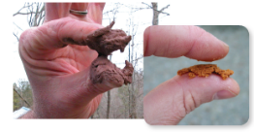
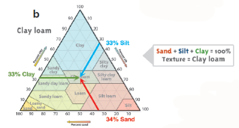

Soil Texture
Texture by feel
Soil Textural Triangle
Source: Know Soil, Know Life; D. Lindbo; USDA-NRCS
Soil Science Society of America

Slide 8

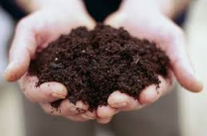
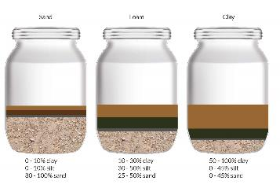
Soil Texture
Ideal soil?
Loam ≠ equal parts of sand, silt & clay
www.primose.co.uk
Source: Getty images; blog.primrose.co.uk
Soil Science Society of America

Slide 9
Soil Structure
Soil structure describes the arrangement of primary particles.
They are naturally occurring arrangement.
A well-structured soil has an abundance of pores spaces for water, air, and root systems.
Soil Science Society of America

Slide 10
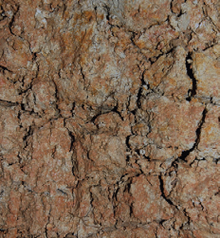
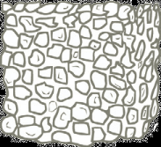
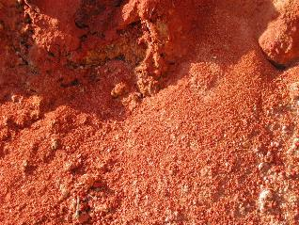

Soil Structure
Granular
Blocky
Source: Know Soil, Know Life, SSSA
Soil Science Society of America

Slide 11
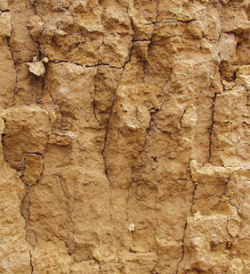
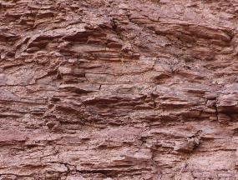

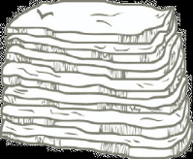
Soil Structure
Platy
Columnar or prismatic
Source: Know Soil, Know Life, SSSA
Soil Science Society of America

Slide 12
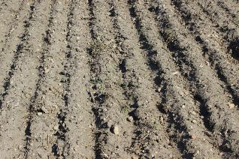

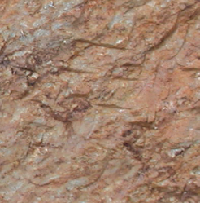
Soil Structure
Massive
Single grained
Source: Know Soil, Know Life, SSSA
Soil Science Society of America

Slide 13
Poll question!
Which of these soil structures will allow water to
move fastest through the soil?
Soil Science Society of America

Slide 14
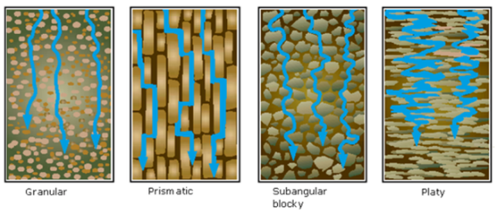
Effects of Soil Characteristics
Water flow through different soil structures
Source: USDA-NRCS
Soil Science Society of America

Slide 15
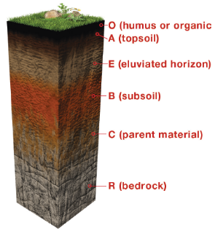
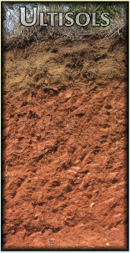
Soil Profile
Source: Soil! Get the Inside Scoop, SSSA; USDA-NRCS
Soil Science Society of America

Slide 16
Why are these soil characteristics important?
Soils have identities: the characteristics are used for soil classification, to distinguish between soils.
They influence:
      water movement into the soil (infiltration)
      Water movement within the soil (percolation)
      water storage for plants
      soil erosion
      nutrient status & supply to plants
      heat transfer
      ease of tillage
      root growth
Soil Science Society of America

Slide 17
Soil Fertility
Soil Science Society of America

Slide 18
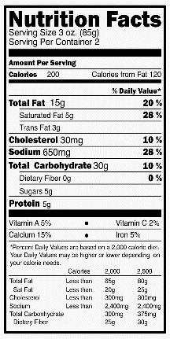
Soil Fertility
Applying the soil science basics!
Ability of soil to provide nutrients to crops
Basis of our food, fiber, and pharmaceuticals
https://www.forksoverknives.com/reading-food-packages-and-nutrition-labels-four-tips-for-savvy-shopping/#gs.470A_Cs
Soil Science Society of America
Notes:
Soil Fertility is the ability of soil to supply essential nutrients to plants.

Slide 19
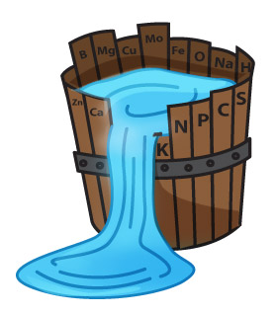
Essential Plant Nutrients
From air and water
  Carbon (C), Hydrogen (H), Oxygen(O)
Macronutrients
  Nitrogen (N), Phosphorus (P), Potassium (K)
Secondary Macros
  Sulfur (S), Calcium (Ca), Magnesium (Mg)
Micronutrients
  Boron (B), Chlorine (Cl), Copper (Cu), Iron (Fe), Manganese
  (Mn), Molybdenum (Mo), Zinc (Zn), Nickel (Ni)
Beneficial
  Cobalt (Co), Sodium (Na), Silicon (Si)
Source: http://www.earthfoods.khaiel.com/en/sub0301.php
Soil Science Society of America
Notes:
The category of each nutrients is based on how much of that nutrients is taken up by the plants. Even though less of each micronutrient is taken up, it does not mean it is less important!
Law of the minimum

Slide 20
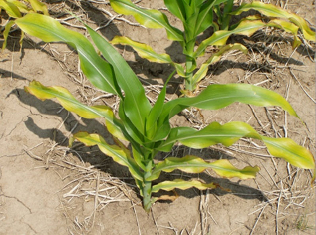
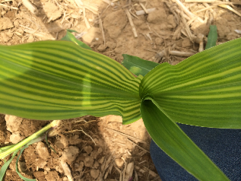
Got Nutrients?
Not Enough….
Too Much….
Source: www.pioneer.com/home/site/us/pioneer_growingpoint_agronomy/2013/evaluation_corn_yield_nutrient/
Source: http://www.knowmoregrowmore.com/8479/does-your-corn-look-like-this/
Soil Science Society of America

Slide 21
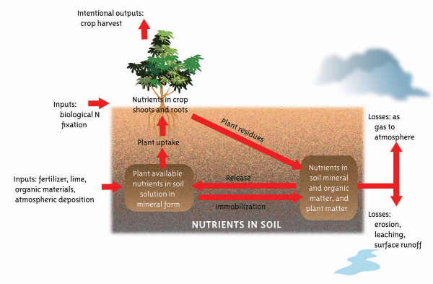
Nutrient Cycle
Source: Know Soil, Know Life, SSSA
Soil Science Society of America
Notes:
Now that we know what nutrients plants need from the soil, let’s talk about where they come from. Nutrients can come from natural processes, such as biological nitrogen fixation, and they can come from agricultural inputs, such as synthetic fertilizer, lime, and organic material. Nutrients in the soil are only taken up by plants in forms the plant can use. The nutrients are removed during crop harvest, or they are returned to the soil through plant residue breaking down. Soil nutrients can also be lost as a gas, or through erosion, leaching, or runoff.

Slide 22
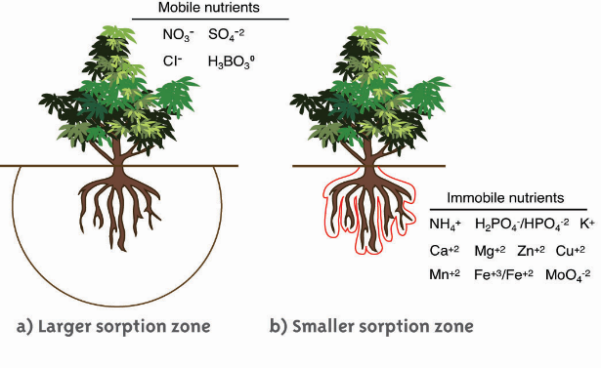
Nutrient Movement
Source: Know Soil, Know Life, SSSA
Soil Science Society of America
Notes:
Now we have a general picture of nutrient cycles, but we also should consider how easily different nutrients move through soils. Scientists classify nutrients as mobile or immobile based on their characteristics. Mobile nutrients move easily to root surfaces from a large volume of oil, while immobile nutrients, which do not move as easily, are only accessible to plants if they are close to the roots.
Understanding nutrient mobility in soil is important for scientists and farmers to understand in order to manage nutrient applications to maximize plant growth.

Slide 23
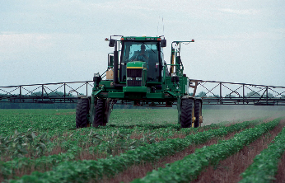
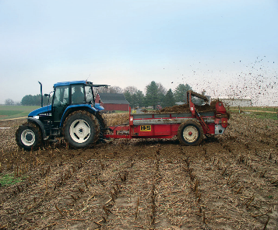
Nutrient Management
The 4 R’s:
Right Time
Right Source
Right Rate
Right Place
Credit; USDA-NRCS
Soil Science Society of America
Notes:
Growers need to apply enough nutrients to ensure plants get what they need while minimizing their input costs, and the impacts on the environment. This can be a complicated equation to balance, so they consider a few different variables: the right time, right source, right rate, and right place, which we refer to as the 4R’s!

Slide 24
Soil Science
Resources
Soil Science Society of America

Slide 25
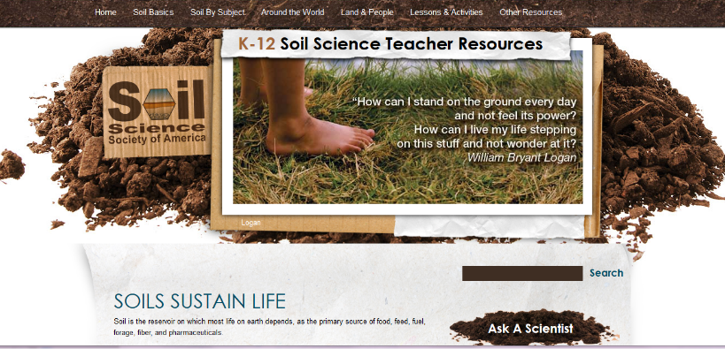
Soil K-12 Resources - www.soils4teachers.org
Soil Science Society of America

Slide 26
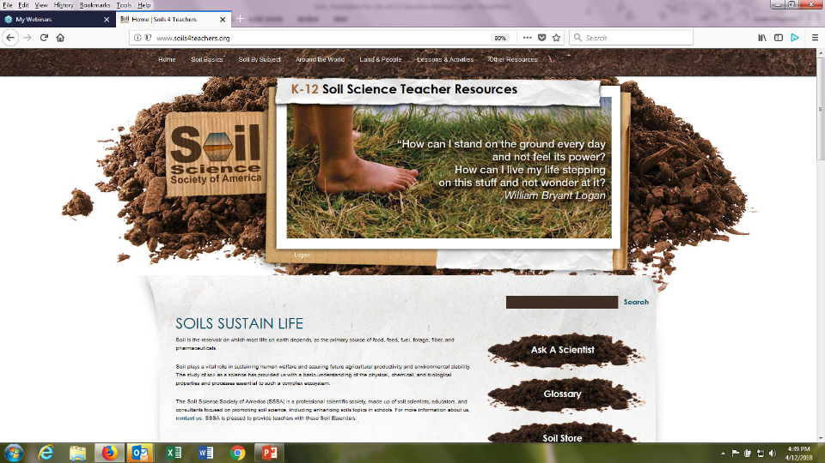

Slide 27
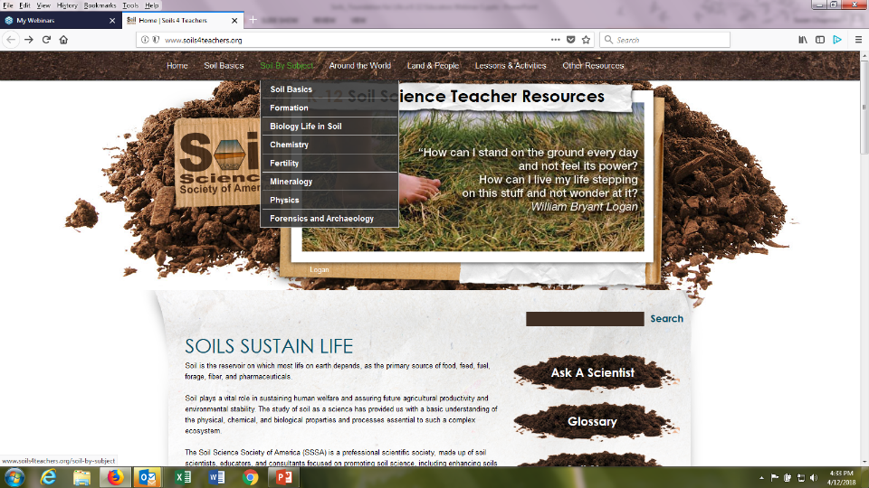

Slide 28
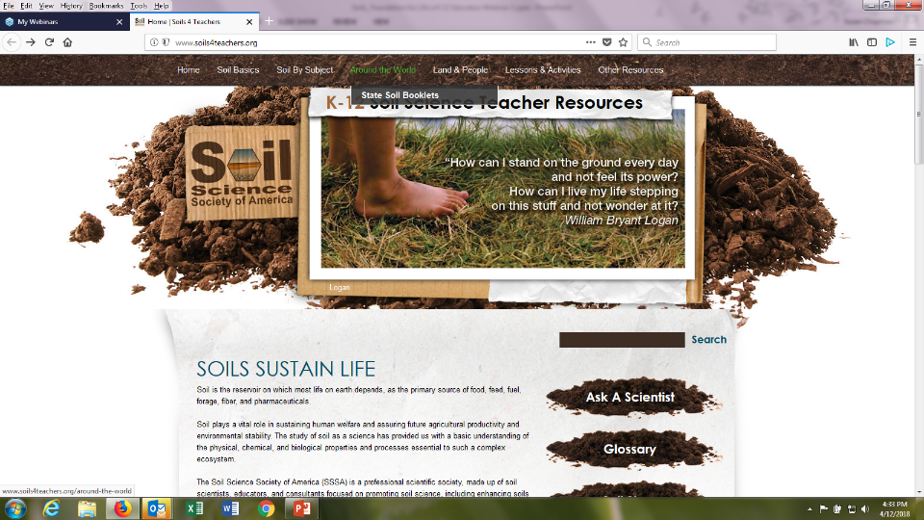

Slide 29
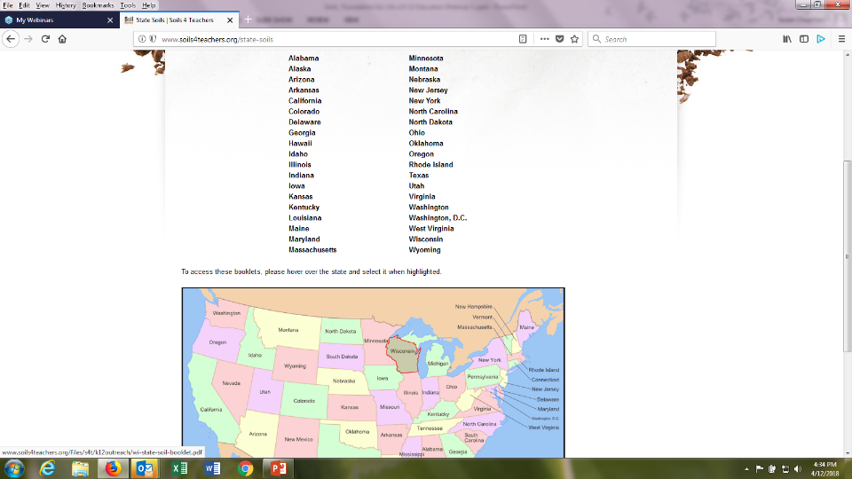

Slide 30
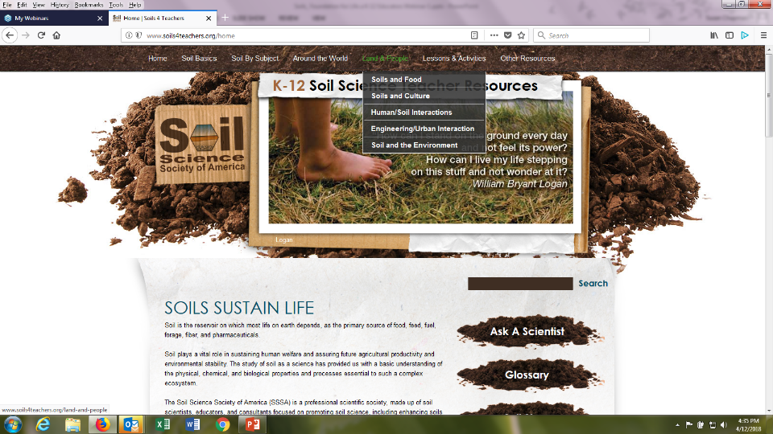

Slide 31
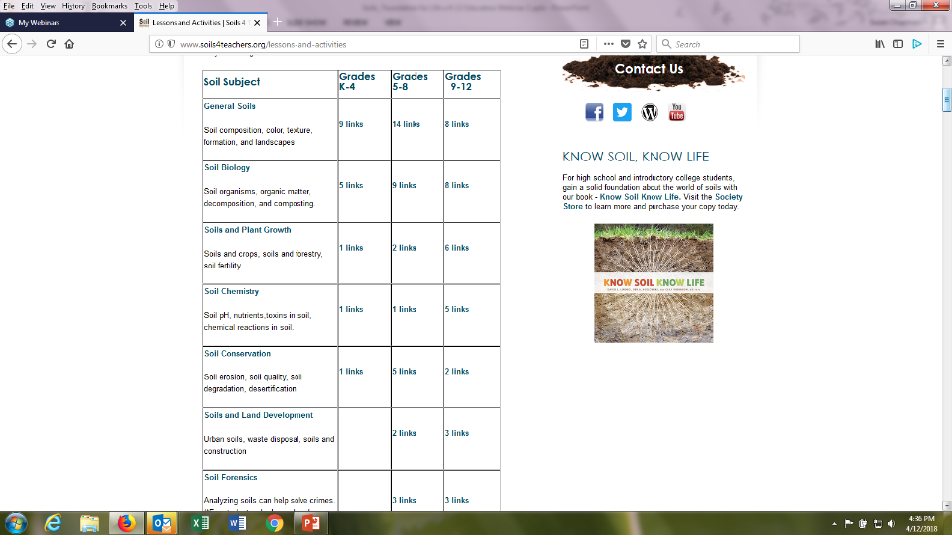

Slide 32
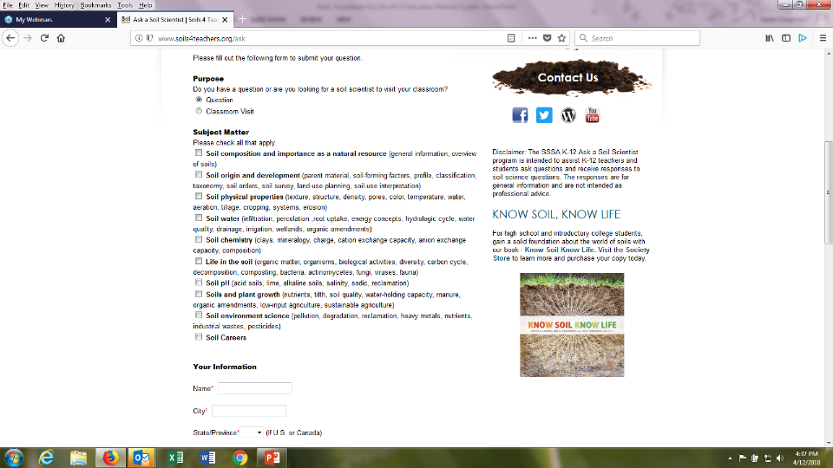

Slide 33
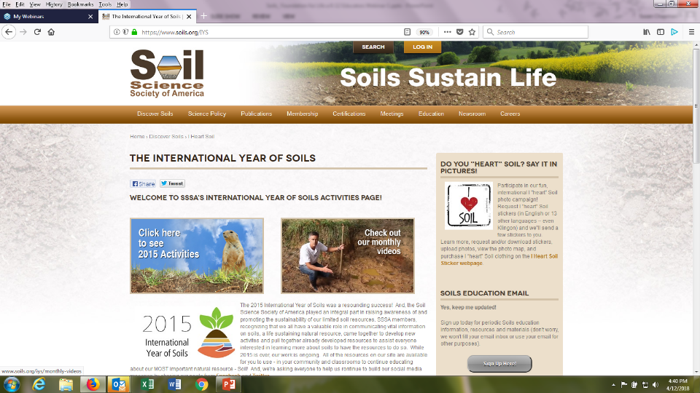

Slide 34
Webinar Resources – www.soils4teachers.org/webinar
The recording will be available on this page as well as related materials and all activities we’ve referenced.
Activity Alert!
Key Resources
  www.soils4teachers.org
  www.soils.org/IYS
  www.soils4kids.org
  www.soils.org/discover-soils
Soil Science Society of America

Slide 35
Thank You for Attending!
Questions?
Soil Science Society of America

